Slide 1
Project 6 Changes

Slide 2
Download the following files from Canvas:
Model_Composite_2Link_NN (Simulink file that has the controller)
Neural_Networks (Matlab file where you pick your gains and run the script)

Slide 3
Re-saving the files
This project requires 3 controllers with NN:
Standard adaptive
Sliding Mode (sliding chode)
RISE
Therefore you should save both files 3 times, like the following:
 | Simulink Name | MATLAB Name
Standard Adaptive | Model_Composite_2Link_NN_A | Neural_Networks_A
Sliding Chode | Model_Composite_2Link_NN_B | Neural_Networks_B
RISE | Model_Composite_2Link_NN_C | Neural_Networks_C

Slide 4
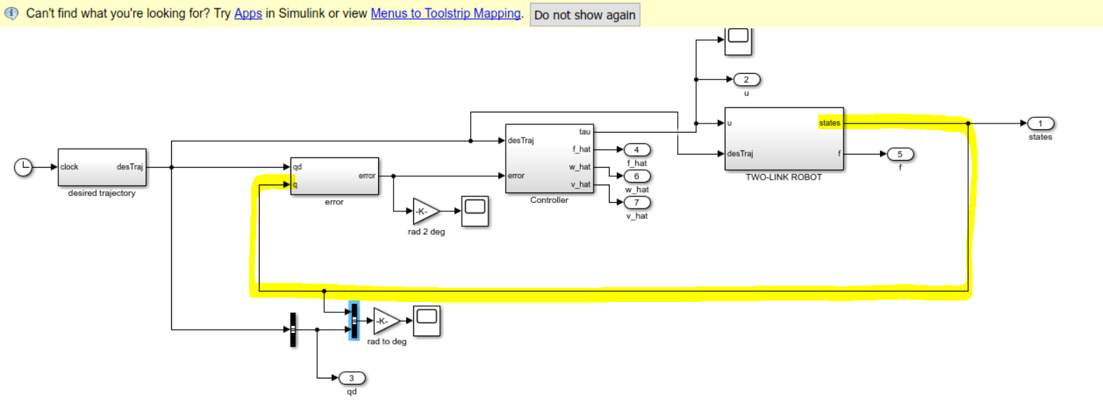
Simulink File
This is the Simulink file when you open it (ignore the yellow line)
1st, open this block so you can edit the Desired Trajectory:

Slide 5
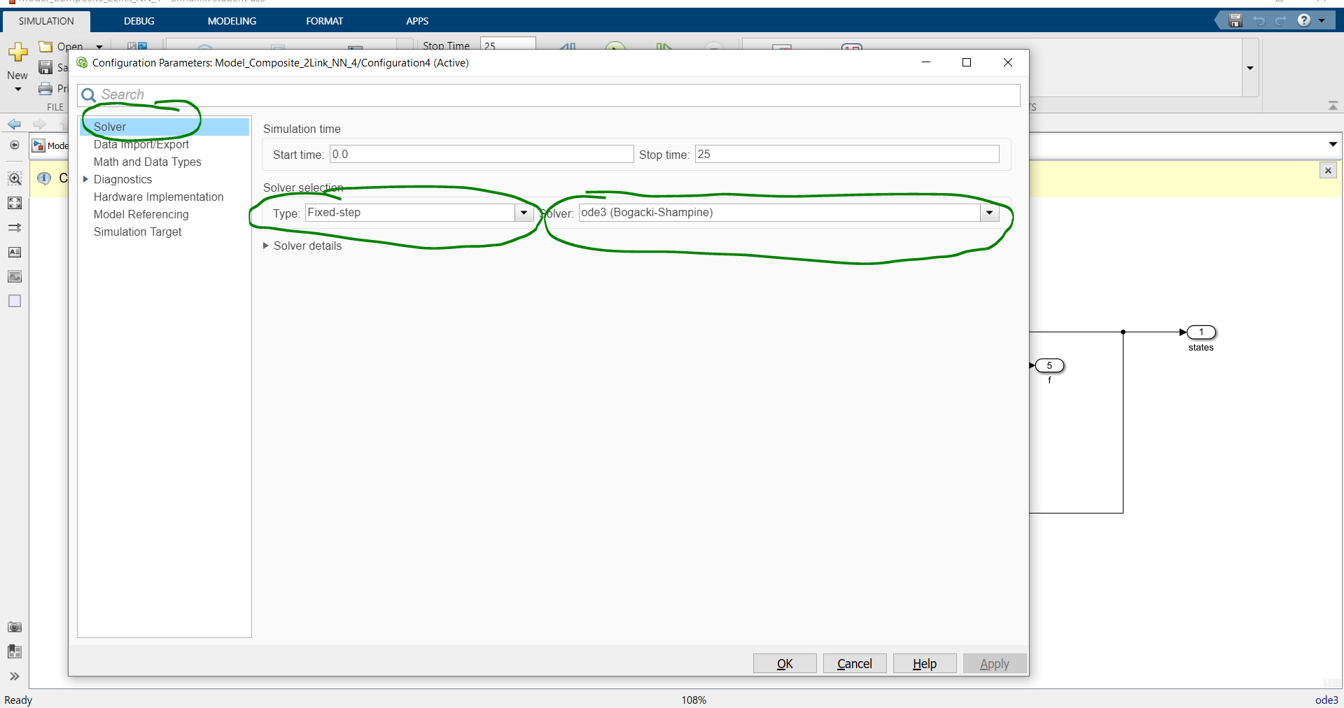
ODE3 vs. ODE45
If running the code takes too long, you can try switching from ODE45 (variable step solver) to ODE3 (fixed step solver). ODE3 still takes time, but not as long as ODE45.
In the main Simulink Window, press “Ctrl+E” to open the Config. Param. Window, and change to ODE3.

Slide 6
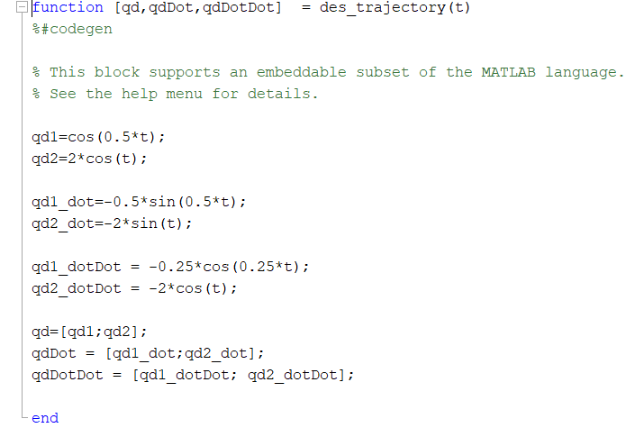
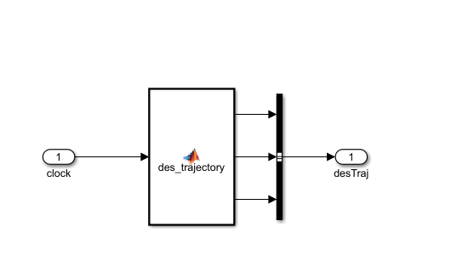
Editing Desired Trajectory
Desired trajectories are wrong in the downloaded file, make sure you fix them.
Double click to open

Slide 7
Editing the Controller:
Double click to open

Slide 8
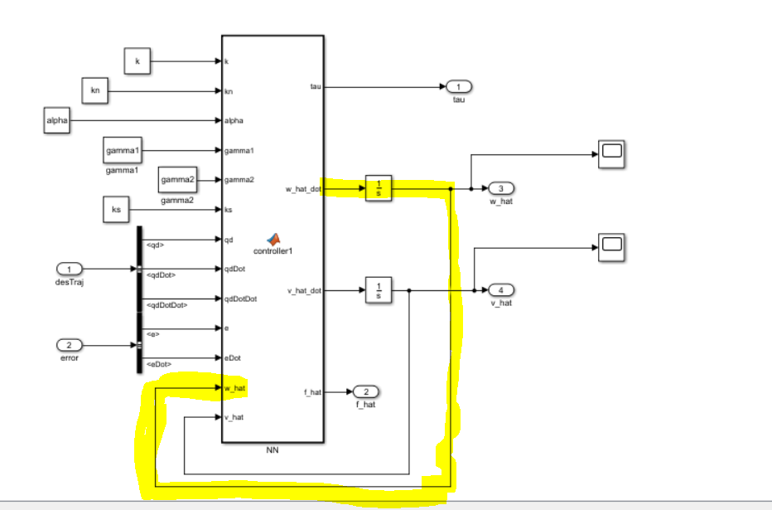
Editing the Controller:
This is what the controller block looks like when you open it (ignore yellow line)
Double click to open

Slide 9
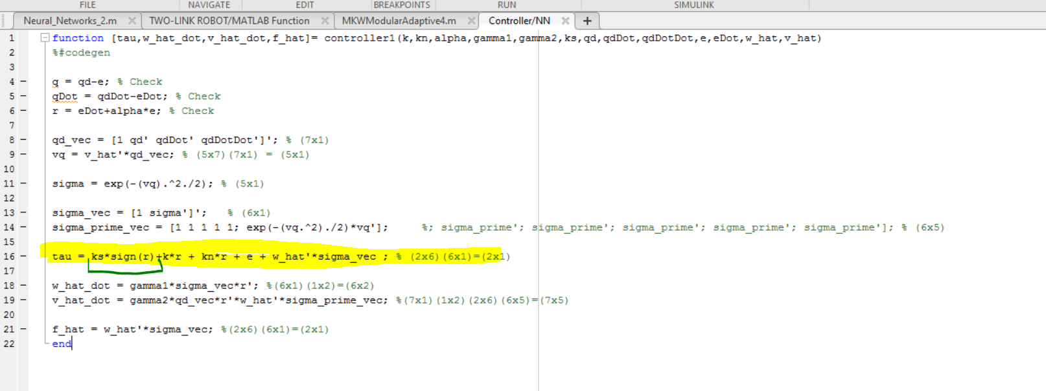
Editing the Controller:
When you open the controller, it’ll open this script here. This is the script that governs how the controller works. Dr. Dixon already gave us the sliding mode controller
To switch from the sliding more controller to the “continuous feedback control, delete the sliding mode part. (Not 100% sure about this).

Slide 10
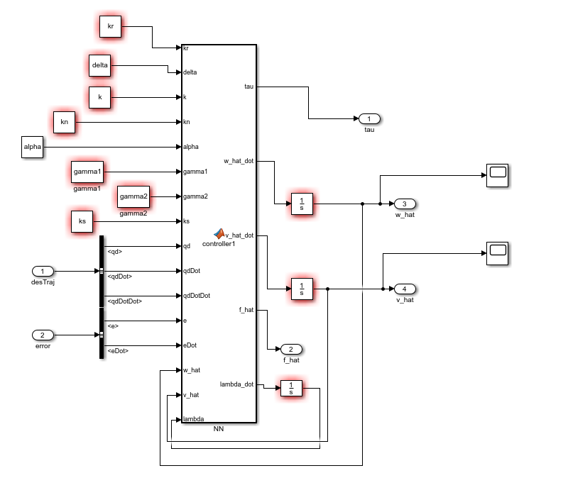
RISE
Now that we’ve done the first 2 controllers, now we do RISE:
When you are done with the RISE, the final control block will look like this. Ignore the blocks that have red borders. These borders exist because I haven’t run the MATLAB code yet. The MATLAB code is what establishes the values of these constants in the workspace. Therfore, if you run the MATLAB code and you still see some of these blocks are red, then you know that you haven’t properly assigned a value in your MATLAB script
Establish these two new gain blocks for your RISE controller
Establish a new integral for your integral RISE term. Use any notation you want Make sure you put the integrator block as well

Slide 11
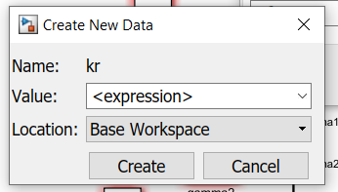
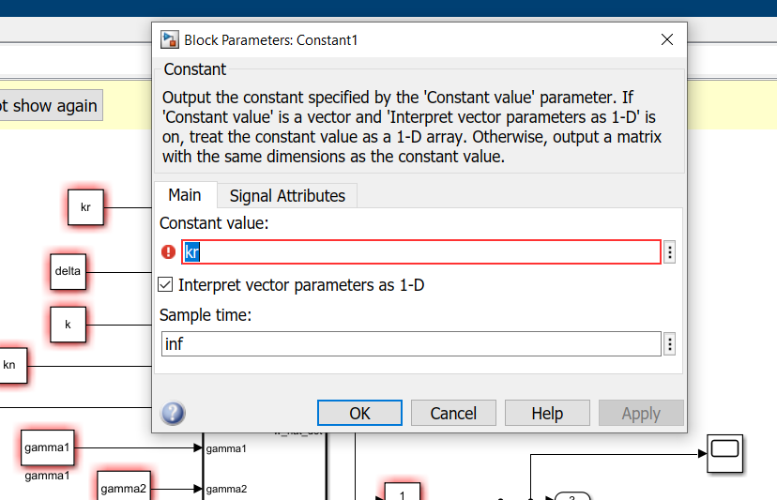
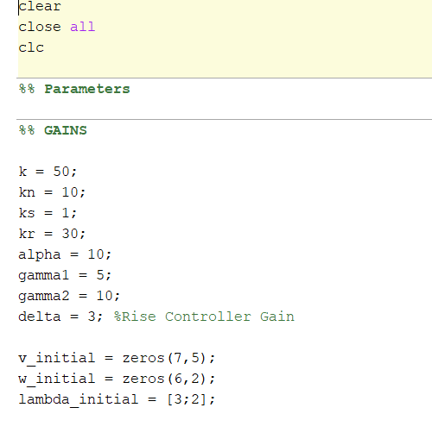
RISE: Editing Gain Blocks
1) Double click to open
3) Toggle this option
2) Click this to edit option
4) Make sure you update your script

Slide 12
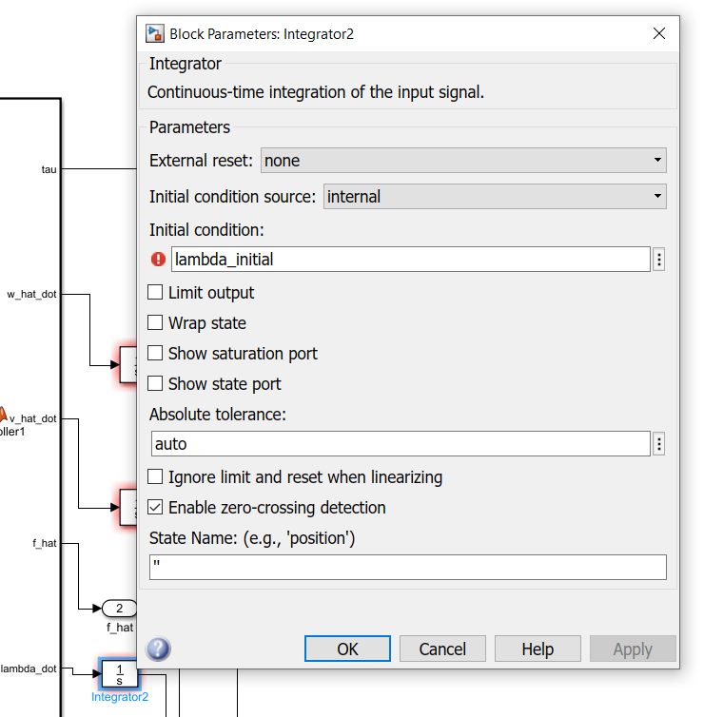
RISE: Editing Integrator block
Do the exact same thing with the integrator block. Make sure you have an initial condition for your integrator block, and you also update that in the script

Slide 13
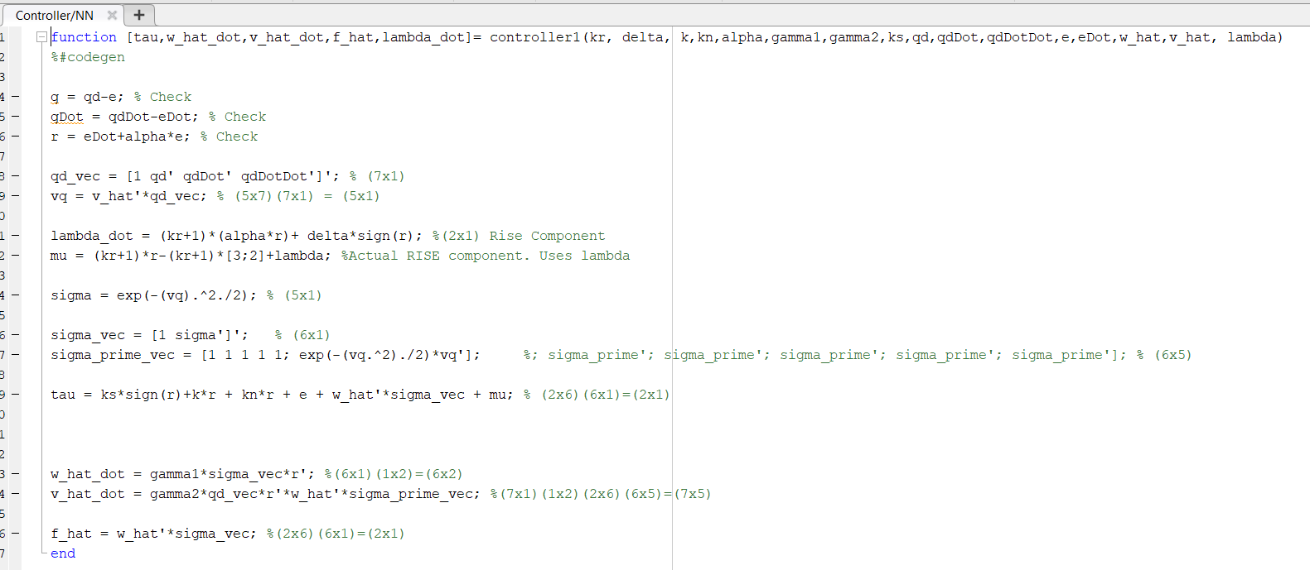
RISE Controller Code:
Outputs
Inputs
Add these

Slide 14
Running the RISE Controller
It should take several minutes to run. Sometimes almost 10-15 minutes. If it goes even longer, I suggest Pausing and trying to terminate the code. Sometimes doing that will make itself finish and you’ll get the plots.

Slide 15
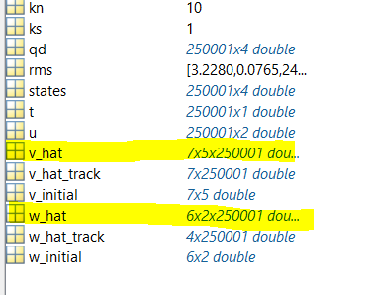
Plotting v_hat and w_hat
Disclaimer: not 100% sure if this is right (much like the rest of the project).
Problem: w_hat and v_hat are 3-dimension vectors, so how do we plot them?

Slide 16
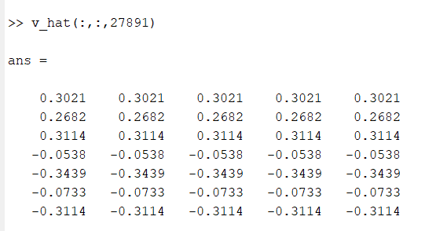
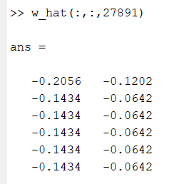
Plotting v_hat and w_hat
For every layer of v_hat, we see that only the rows are unique (each column repeats itself)
For every layer of w_hat, we see that only the rows are unique (each column repeats itself)

Slide 17
Plotting v_hat and w_hat
1st
layer
2nd
layer
3rd
layer
Nth
layer
…
For v_hat, we will pull the 1st column of every layer:
…
1st
layer
2nd
layer
3rd
layer
Nth
layer
…
For every w_hat, we will pull the 1st two rows o f each layer, and re-arrange them into a column (to turn 3-D matrix to 2-D)
…

Slide 18
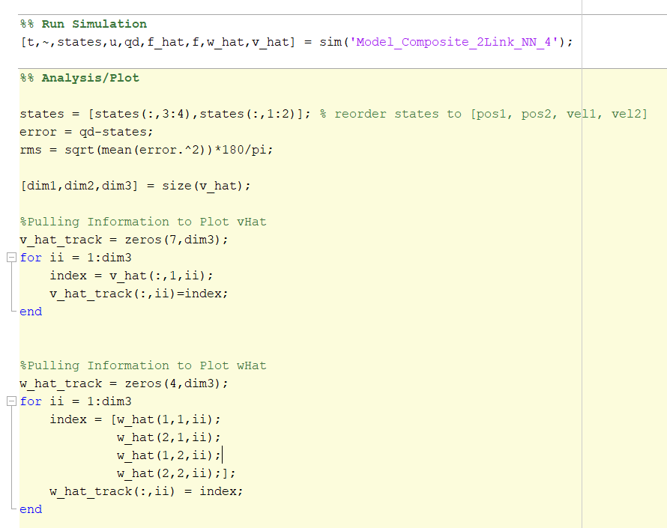
MATLAB Code to Plot w_hat and v_hat
Highlight to copy code below:
[dim1,dim2,dim3] = size(v_hat);
%Pulling Information to Plot vHat
v_hat_track = zeros(7,dim3);
for ii = 1:dim3
index = v_hat(:,1,ii);
v_hat_track(:,ii)=index;
end
%Pulling Information to Plot wHat
w_hat_track = zeros(4,dim3);
for ii = 1:dim3
index = [w_hat(1,1,ii);
w_hat(2,1,ii);
w_hat(1,2,ii);
w_hat(2,2,ii);];
w_hat_track(:,ii) = index;
end
The plotting code goes after the simulation piece:

Slide 19
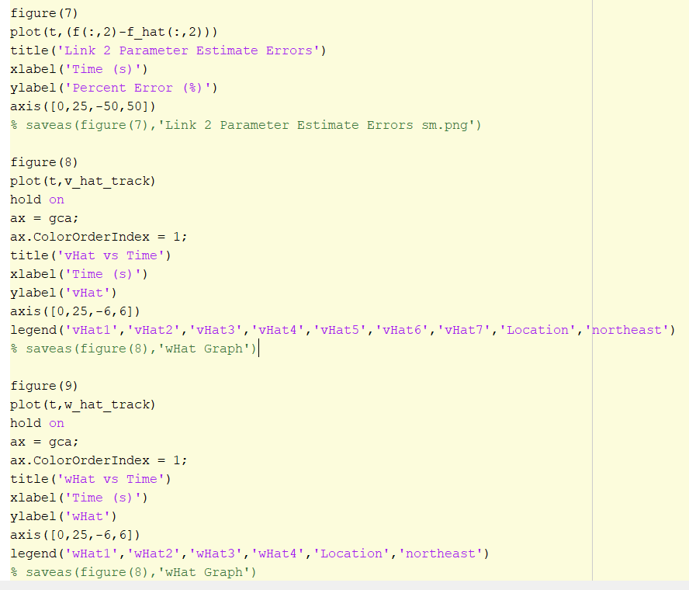
MATLAB Code to Plot w_hat and v_hat
Syntax for actually plotting:
Highlight to copy code below:
figure(8)
plot(t,v_hat_track)
hold on
ax = gca;
ax.ColorOrderIndex = 1;
title('vHat vs Time')
xlabel('Time (s)')
ylabel('vHat')
axis([0,25,-6,6])
legend('vHat1','vHat2','vHat3','vHat4','vHat5','vHat6','vHat7','Location','northeast')
% saveas(figure(8),'wHat Graph')
figure(9)
plot(t,w_hat_track)
hold on
ax = gca;
ax.ColorOrderIndex = 1;
title('wHat vs Time')
xlabel('Time (s)')
ylabel('wHat')
axis([0,25,-6,6])
legend('wHat1','wHat2','wHat3','wHat4','Location','northeast')
% saveas(figure(8),'wHat Graph')

Slide 20
Projection Function on v_hat and w_hat
According to lectures, we need a projection function for the analysis portion of the NN to ensure that v_hat and w_hat are upperbounded by a constant.
It’s debatable if projection function is needed in this simulation or not (simulation appears to work perfectly fine without applying projection function)

Slide 21
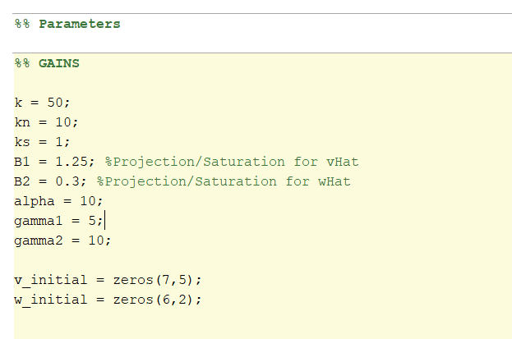
Projection Function on v_hat and w_hat
Start by creating 2 new variables for projection function (you can use any variable name).

Slide 22
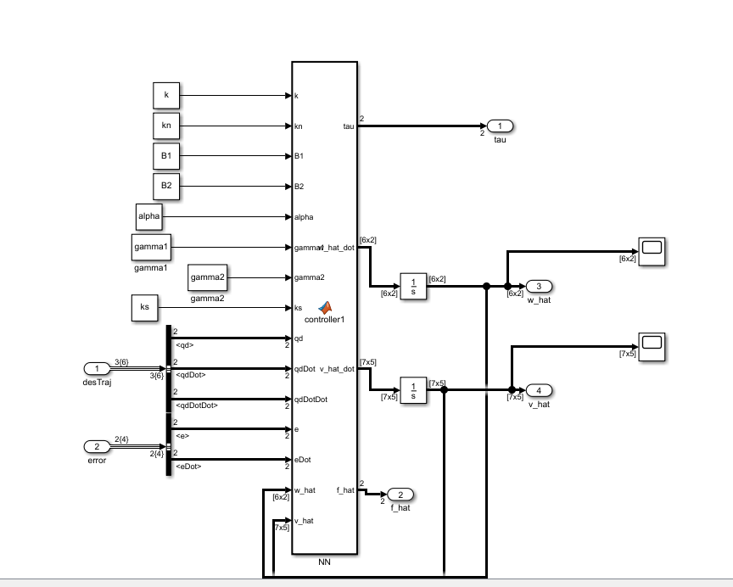
Projection Function on v_hat and w_hat
Remember to create two new constant/gain blocks in your controller diagram

Slide 23
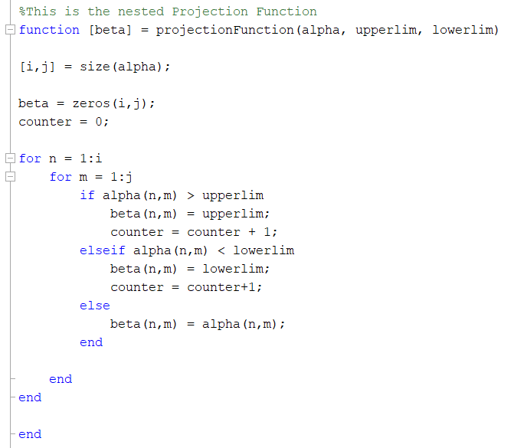
Projection Function on v_hat and w_hat
Highlight to copy code below:
function [beta] = projectionFunction(alpha, upperlim, lowerlim)
[i,j] = size(alpha);
beta = zeros(i,j);
for n = 1:i
for m = 1:j
if alpha(n,m) > upperlim
beta(n,m) = upperlim;
elseif alpha(n,m) < lowerlim
beta(n,m) = lowerlim;
else
beta(n,m) = alpha(n,m);
end
end
end
end
You will need a function to actually implement the projection function on each layer of w_hat and v_hat. Dr. Dixon uploaded his own version on Canvas. The version posted here is very similar. Use whichever.

Slide 24
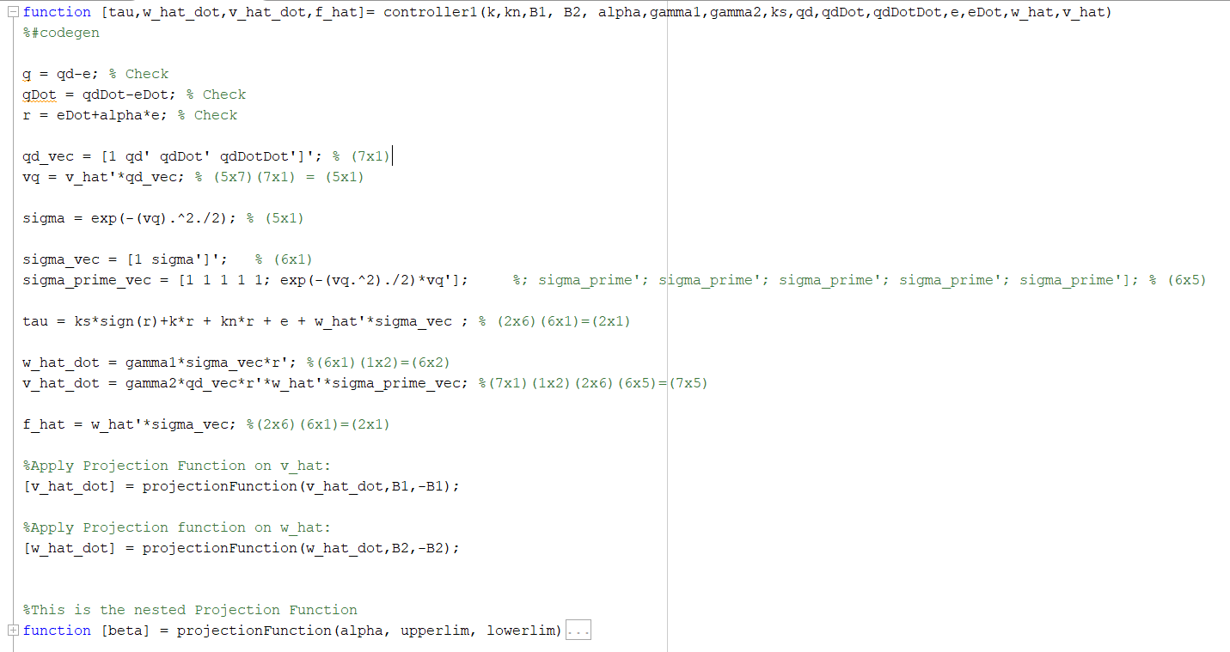
Projection Function on v_hat and w_hat
1) Update the top with projection variables
3) Call Projection Function. Make sure to properly apply B1 and B2 to v_hat and w_hat respectively.
2) Insert Projection Function at bottom of Controller Script

